Slide 1
Key Drivers of Electricity Usage in July
Introduction to Data Science

Slide 2




Background
Global warming is threatening to increase extreme temperatures seen in peak months, namely July
Increased temperatures consequently increase electricity demand, as consumers need to cool their homes and power their devices
Too much demand for electricity may lead to overload ed power grids and cause blackouts
Client wants to avoid having to build additional facilities to support demand

Slide 3
Problem Definition
eSC needs to understand the key drivers of electricity consumption
Determine what kinds of trends exist among high-energy-using homes
Evaluate how energy consumption changes with rising temperatures
Hone in on most meaningful relationships; develop a prediction model
Provide actionable recommendations eSC can promote to reduce energy consumption of key drivers

Slide 4


Available Data
46 counties
Hourly data 2018
Temperature (C)
Relative Humidity (%)
Wind Speed
Wind Direction
Radiation
5710 houses
Homes have unique building id
All counties in SC
Single-Family Residential Homes
171 different attributes
Distinct energy file for each building id
Hourly Data 2018
42 sources of energy consumption
Measured in kWh or kWh/sqft

Slide 5
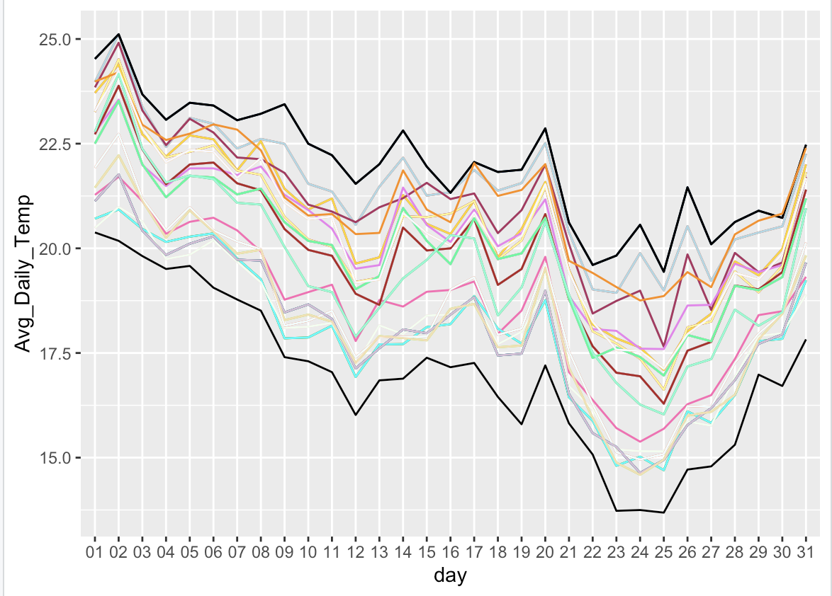
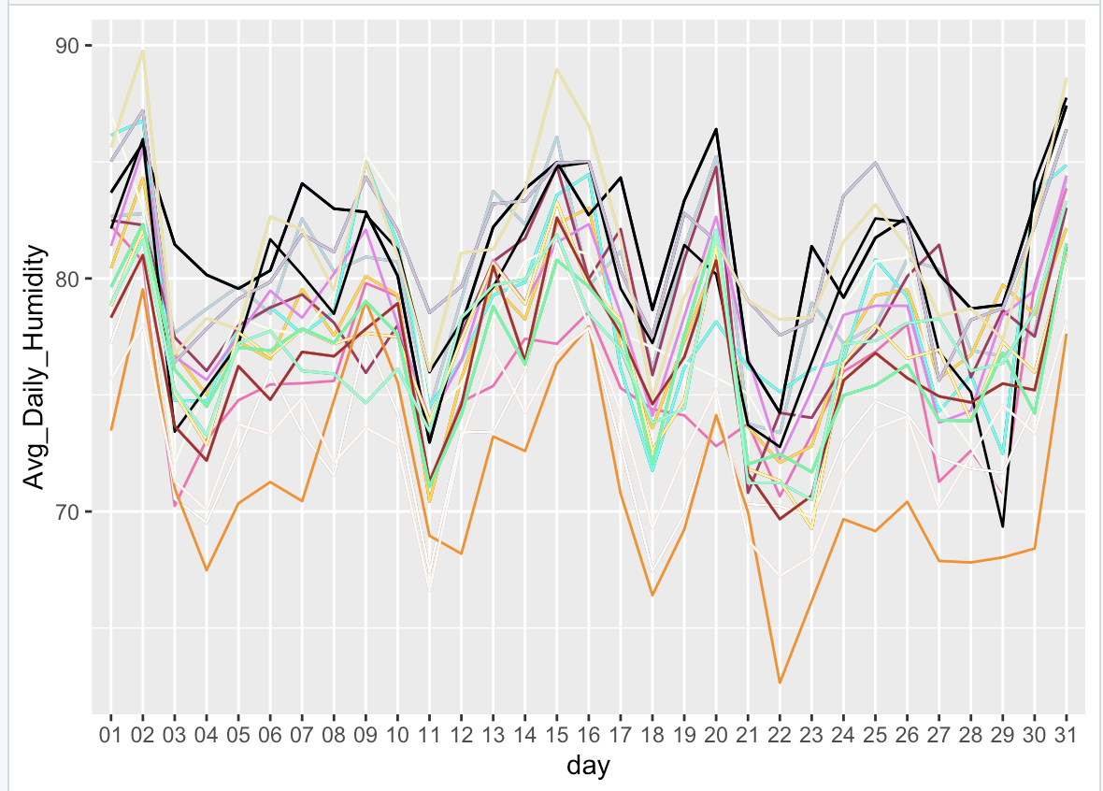
Counties Varied in Daily Temperature, but Followed Trend
Average Daily Temperature for July by County
Average Daily Relative Humidity for July by County

Slide 6

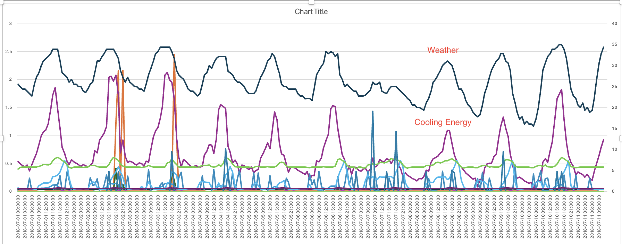
Cooling Energy and Plug Loads Follow Similar Trend to Weather

Slide 7


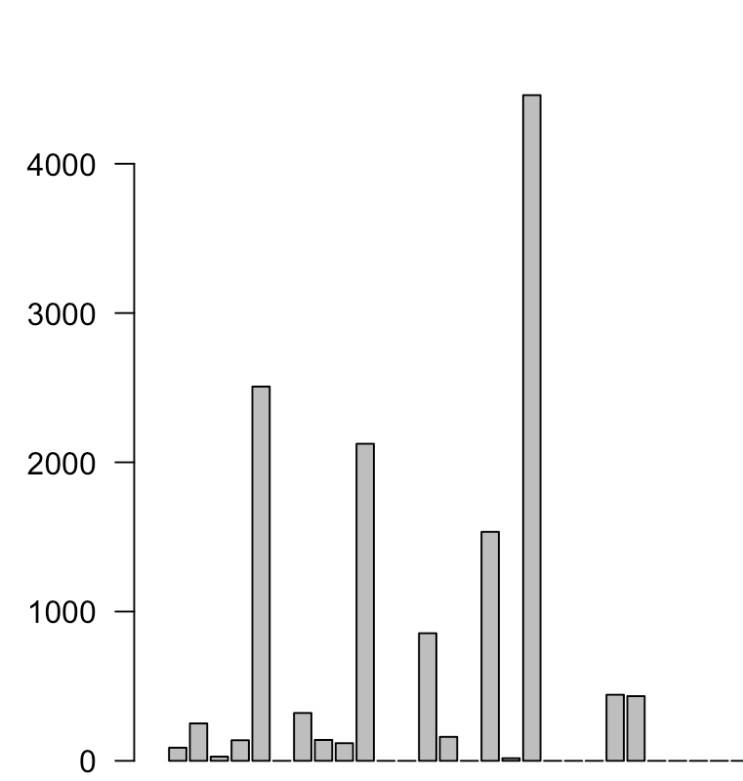

Key Drivers of Electricity Consumption
Total Energy Consumption (kWh)
Cooling Energy
z
Plug Loads
Interior Lighting

Slide 8
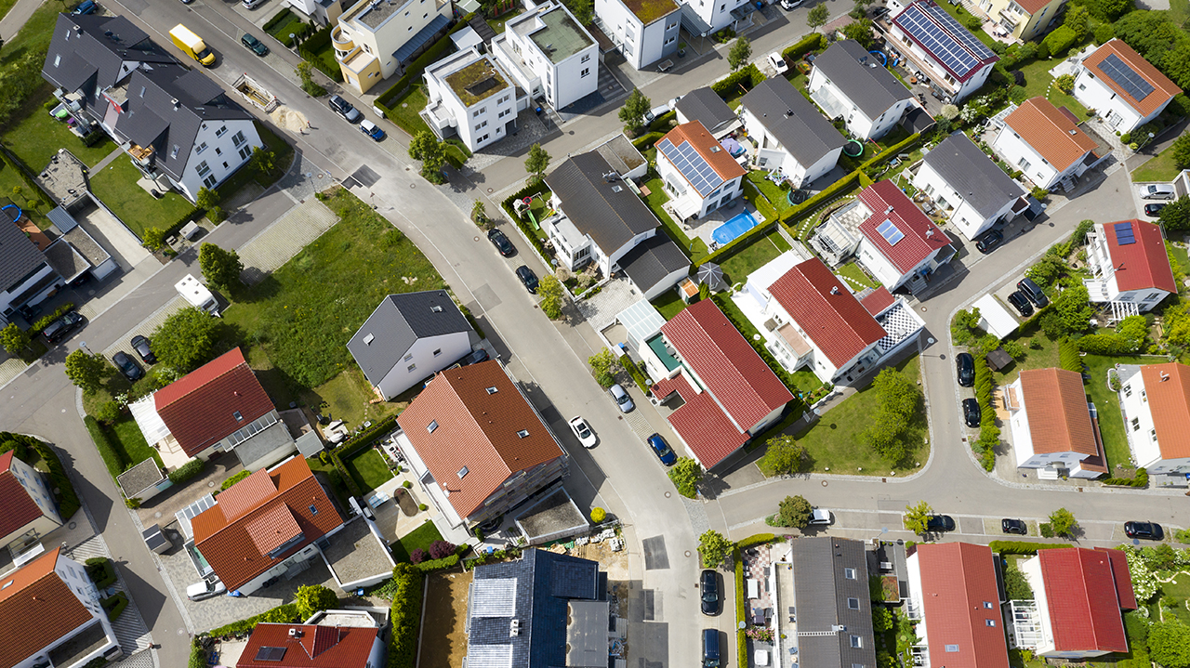
Identifying House Attributes Which Contribute to Key Consumption Drivers
Square Footage
HVAC Type
Location
Number of Occupants
Average Usage
Time of Day
Home Leakage (windows, ducts, insulation)
z

Slide 9
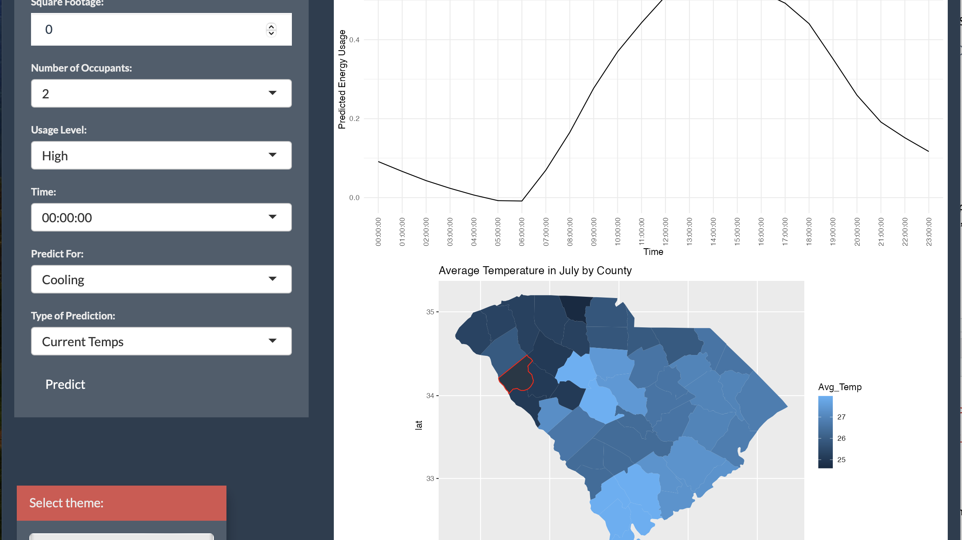
Shiny App Demo
z

Slide 10
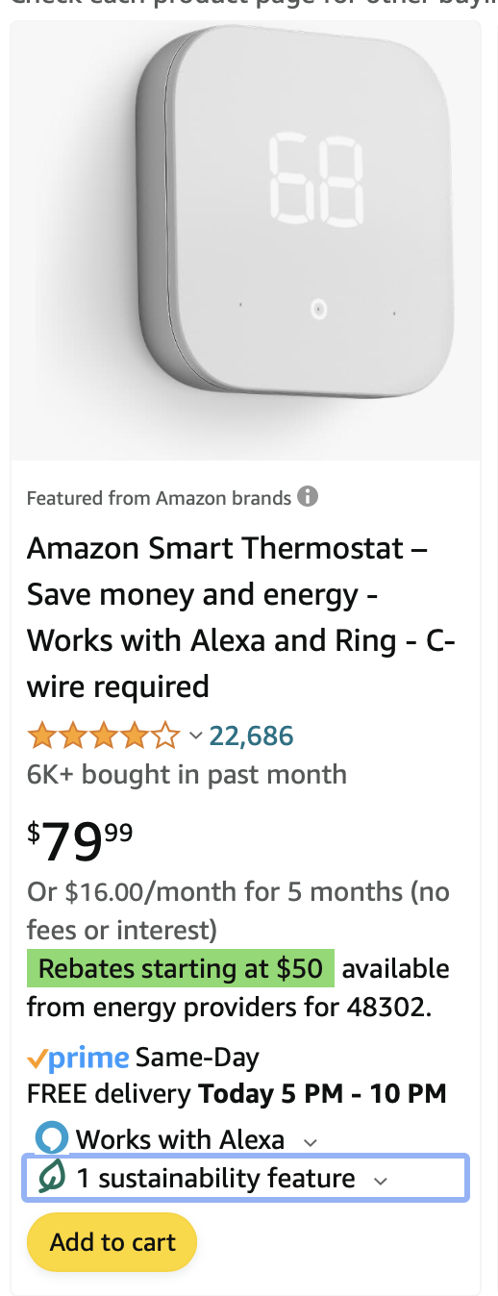
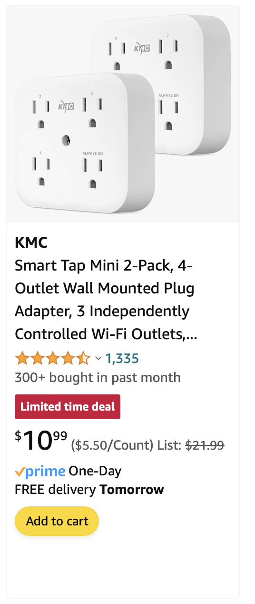
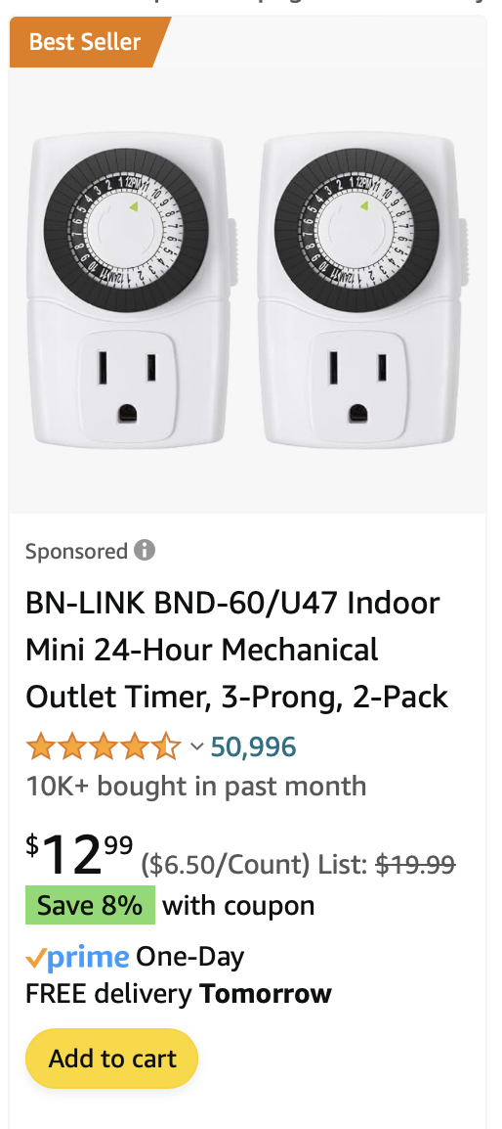
Recommendation
z
Provide smart plugs/light timers to households based on number of occupants
Offer rebate for homeowners who purchase smart thermostat
Monthly reports compare usage to county average
Target High Usage homes first

Slide 11



Follow-up Analysis
Monitor energy usage in these homes for an extended time; compare actual energy usage to our prediction model
Select a subset of houses to supply smart plugs
Determine whether smart plugs are significantly reducing energy consumption in key drivers

